Slide 1
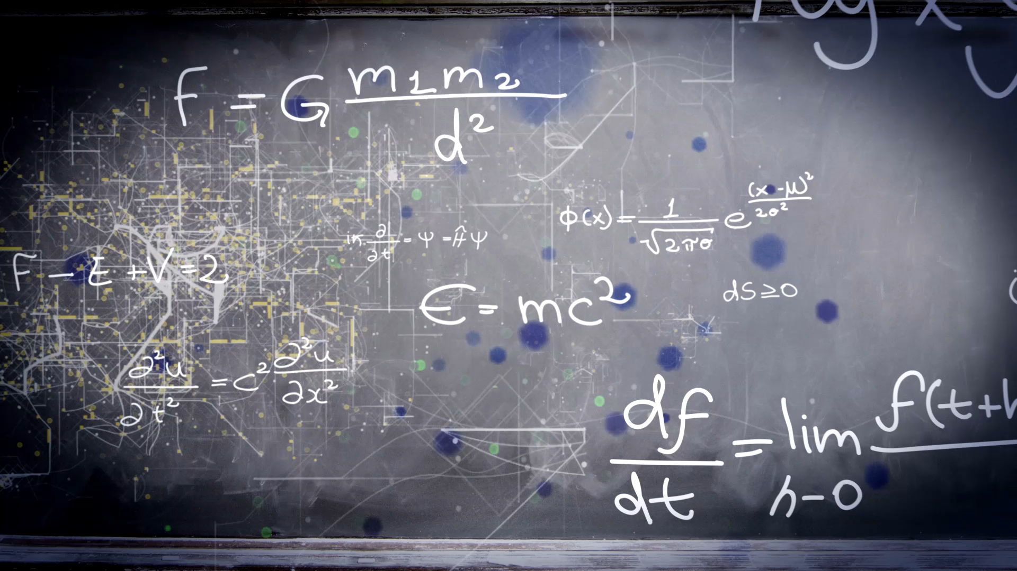
Finite automata
Lyernisha s r
Lecturer, fict

Slide 2
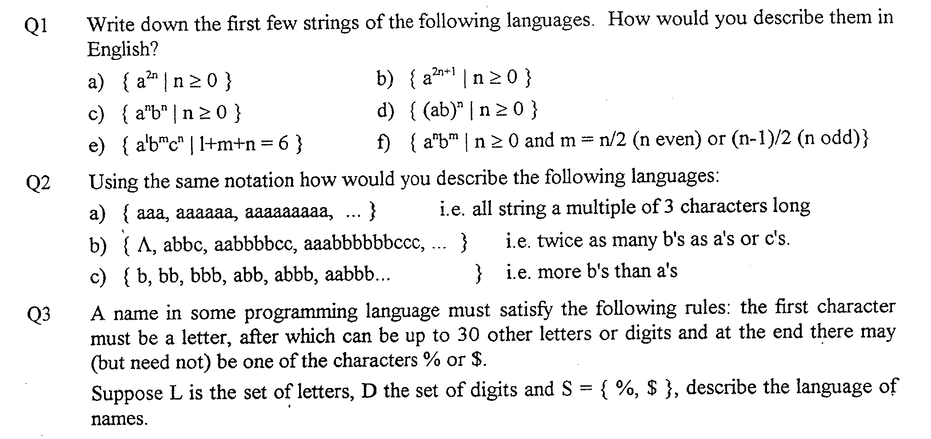
Recap
String and languages

Slide 3
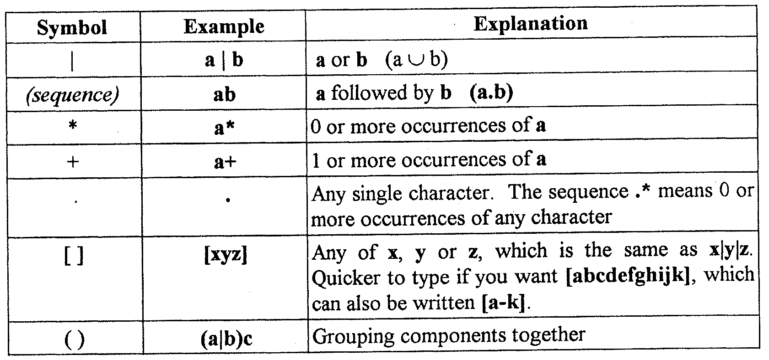
Regular expression

Slide 4
Controlling Things ...
If x has happened then do something
If in state y then do something
change to new state
If x happened while in state y
do something
change to new state

Slide 5
State Transition Table
State | Event | Action | New State
happy | work due next week | none | happy
happy | work due tomorrow | start work | anxious
anxious | Work cancelled | none | happy
anxious | work done | hand in work | happy

Slide 6
State Diagrams
a state transition
A
x
B
when in state A if x happens then
we change to state B

Slide 7
State Transition Diagram
cancelled
start
tomorrow
Happy
Anxious
done
next week

Slide 8
A Finite Automata
cancelled
tomorrow
Happy
Anxious
done
next week

Slide 9
Components
input
symbol
starting state (one
per machine)
d
transition
halting
state
(one or
more)
non-halting
state

Slide 10
Sequence of Input Symbols
What input sequences leave this FA in its halt state?
S1
a
S2
b
ac
ab
abc
abac
yes
no
no
yes
c
S3
{ (ab)^{n}ac | n>=0 }
{ ac, abac, ababac, abababac, ... }

Slide 11
The Original Example ...
Some
acceptable
inputs
cancelled
tomorrow
Happy
Anxious
nnnntc
ntd
Λ
nntcntd
done
next week

Slide 12
Recognising Strings
the set of all strings accepted/recognised
by an FA
=
the language accepted/recognised by the FA

Slide 13
Rejecting Strings
An FA rejects a string if
with some symbols remaining
there is no transition for the next symbol
or
with no symbols remaining
the FA is not in a halt state

Slide 14
Rejected / Accepted Strings
tdnnn yes/no
tdnnt yes/no
n yes/no
ntc yes/no
ntcd yes/no
c
t
Happy
Anxious
d
n

Slide 15
Recall some simple languages ... Can you draw FA to recognise them?
{ Λ, a, aa, aaa, aaaa, ...}
= { a^{n} | n >= 0 }
{ a, aa, aaa, aaaa, ...}
= { a^{n} | n > 0 }
{ 00, 01, 10, 11 }

Slide 16
Non-Deterministic Automata
a
1
2
What happens
here?
b
c
d
cd
cdacd
3
4
d

Slide 17
Non-Deterministic Automata
In deterministic automata, there can never be two transitions to different state for the same input symbol.
If there are more than one transition to different states for the same input symbol, we call it a non-deterministic automata.

Slide 18
Deterministic FAs and Non-Deterministic FAs
For every
non-deterministic FA (NFA)
there is a
deterministic FA (DFA)
which accepts
the same language

Slide 19
A Simple Example
2
NFA
a
b
1
3
a
DFA
a
b

Slide 20
Step by Step (1)
NFA
2
a
b
1
3
a
after ‘a’, must be in
state 2 or 3
a
{ 1 }
{ 2,3 }

Slide 21
Step by Step (2)
NFA
2
a
b
1
3
a
from state 2, read
‘b’, move to state 3
a
b
{3}
{ 1 }
{ 2,3 }

Slide 22
Last Step
NFA
2
a
b
1
3
a
a
b
{ 1 }
{ 2,3 }
{3}
3 is a halt state

Slide 23
A General Algorithm
Write down {1} as the start state of the DFA
Choose a state in the DFA which hasn’t been processed
Work out all transitions from it adding new states
Repeat from step 2 until all states have been processed
Mark halting states

Slide 24
Thank you

